Slide 1
Data visualization

Slide 2
Data is cleaned Now in report view start building the actual Dashboard

Slide 3
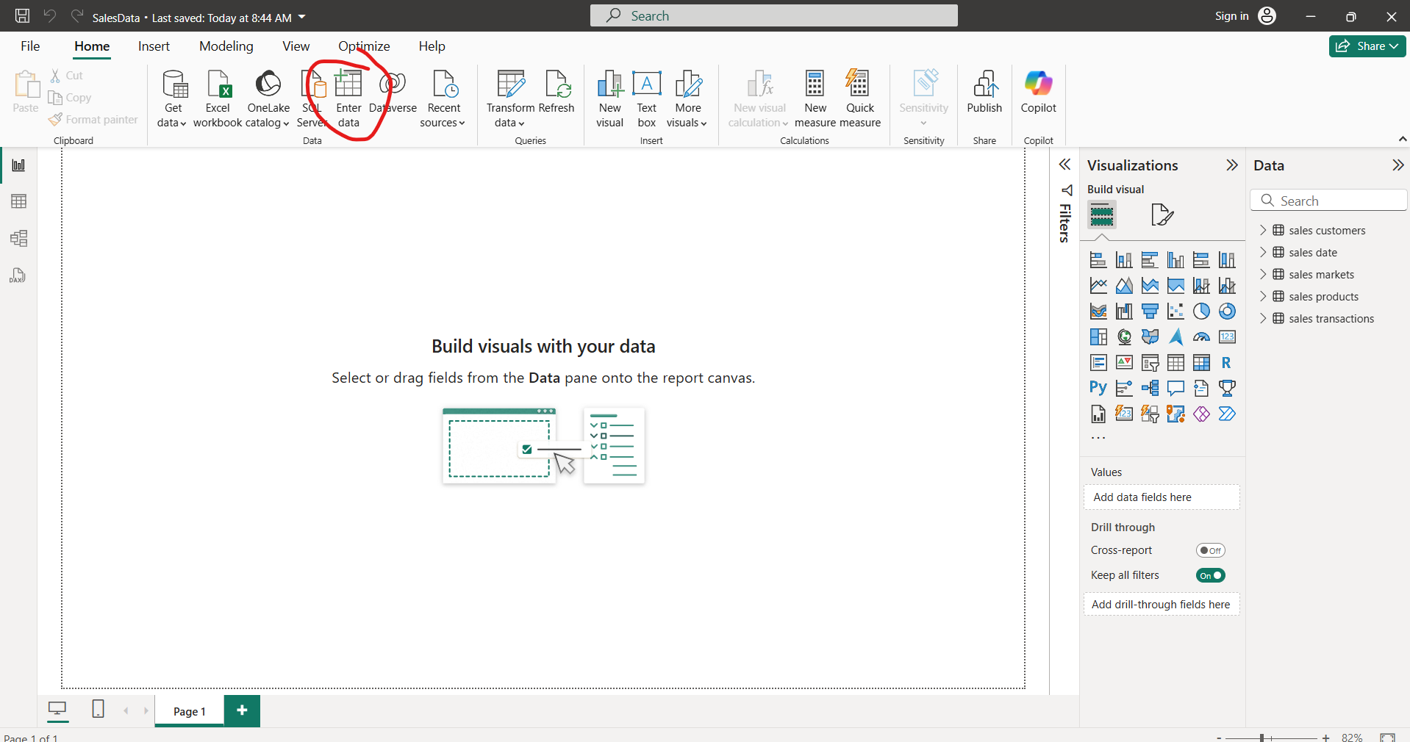
Create Table

Slide 4
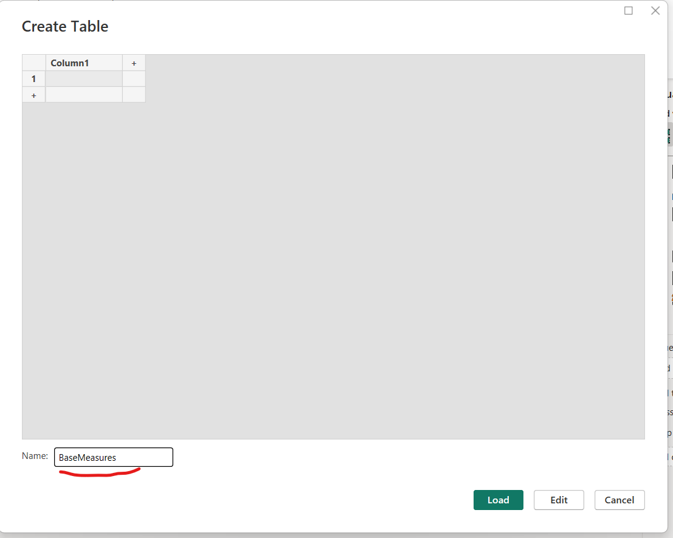
Enter name of the table and click “Load”

Slide 5
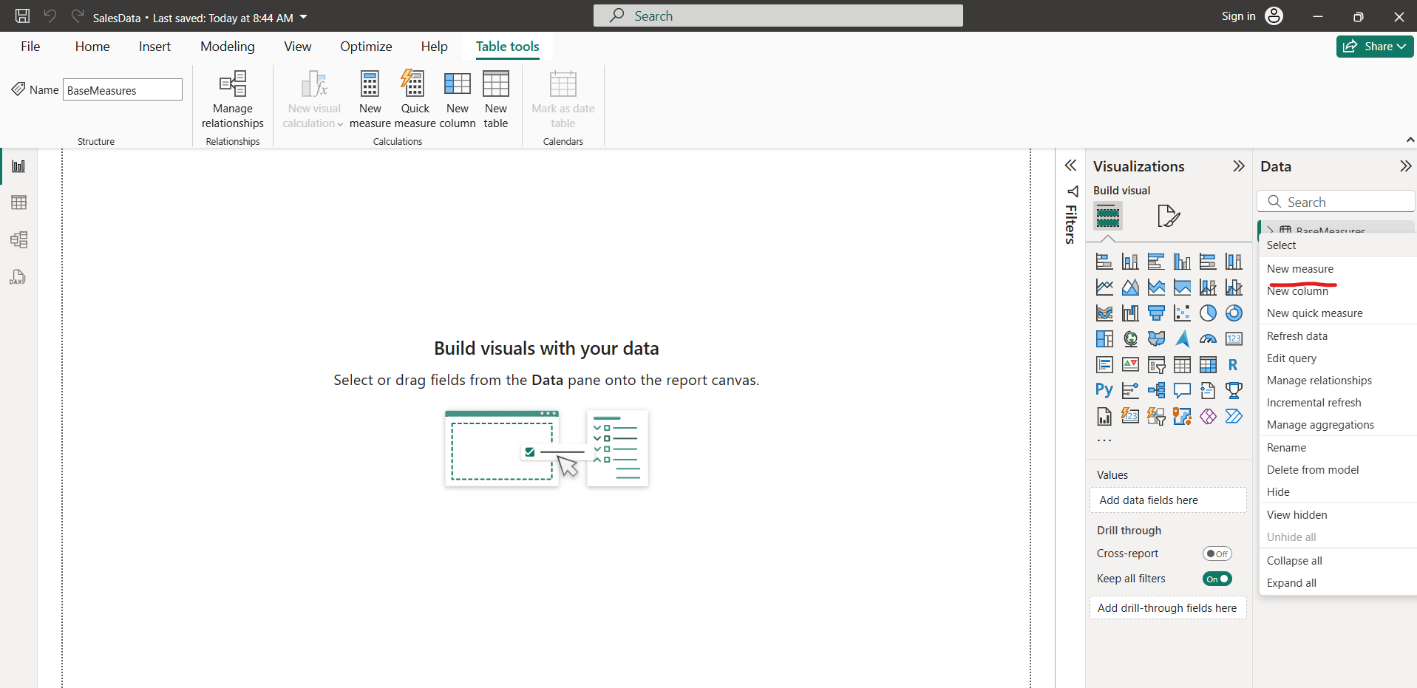
Click on side of BaseMeasure table and click on new measure

Slide 6
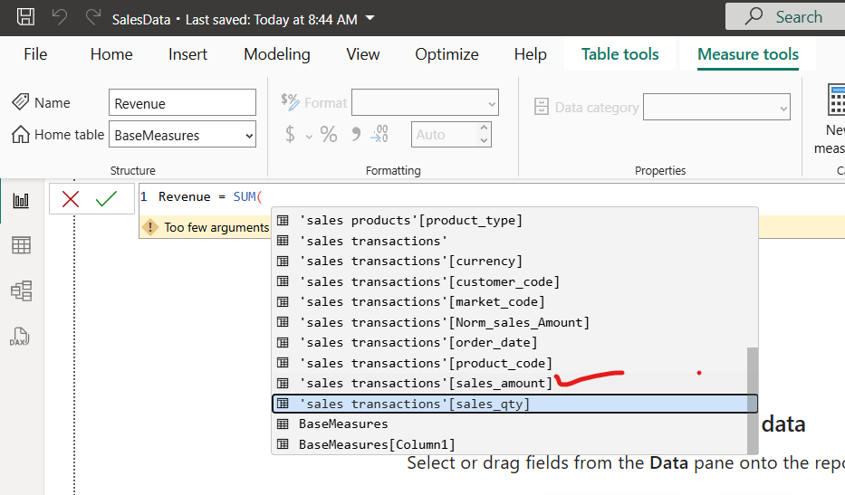
Revenue select sales amount Summing

Slide 7
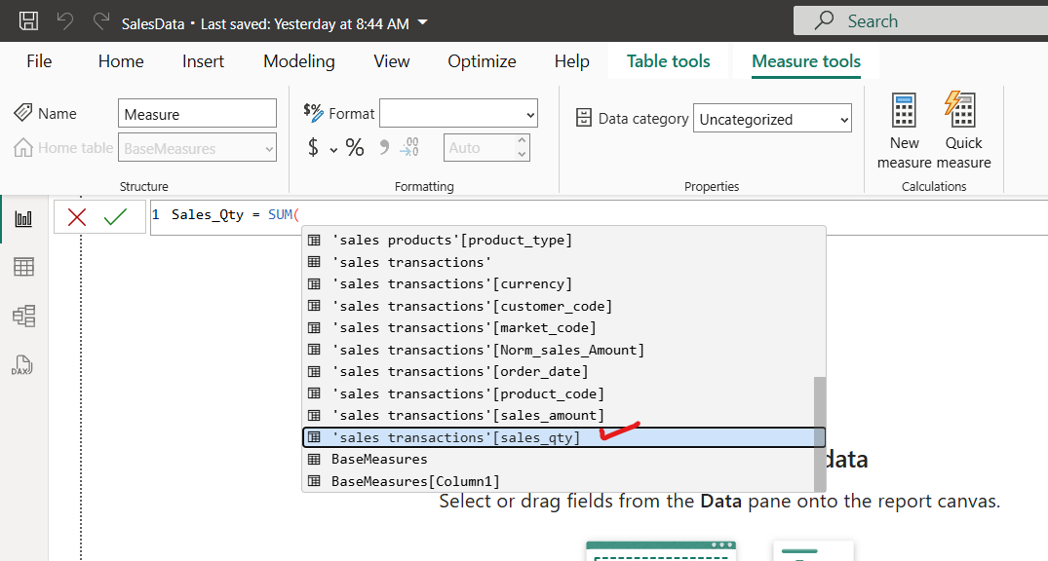
Similarly create another measure of BaseMeasure table name “Sale_Qty”

Slide 8
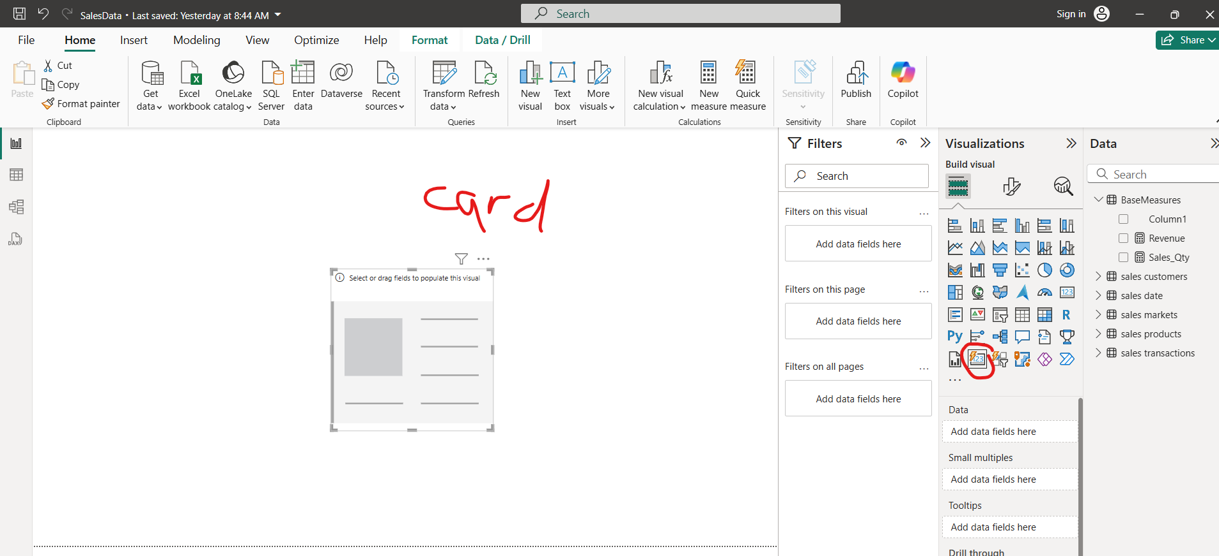
Visualization drag card

Slide 9
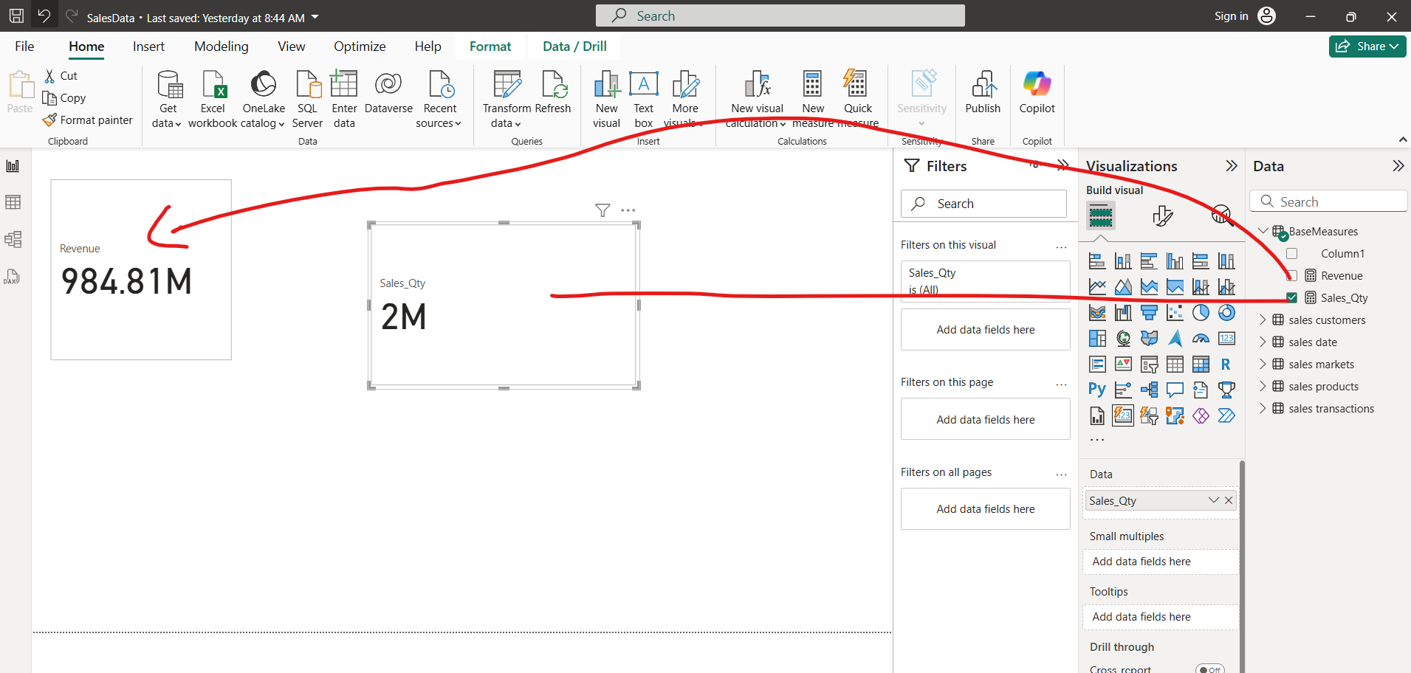
Card and display total revenue and total sales Quantity

Slide 10
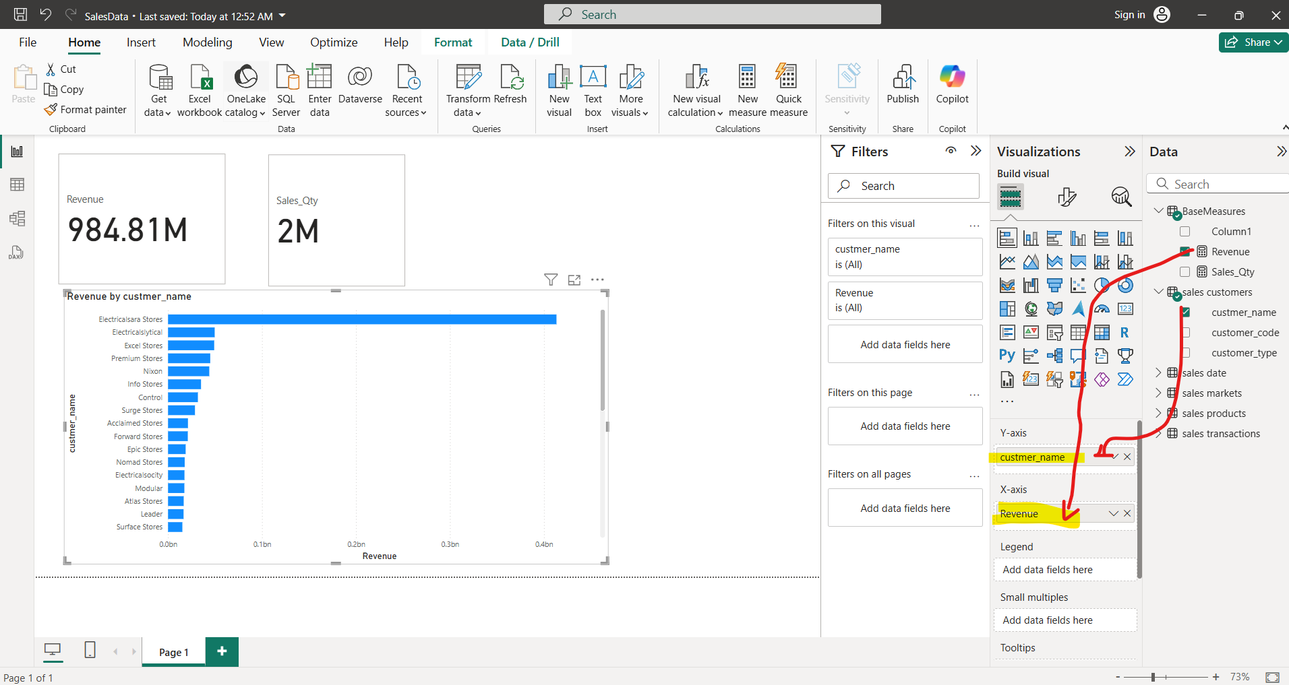
Find Max revenue generated by a customer

Slide 11
Sales Quantity by customer

Slide 12
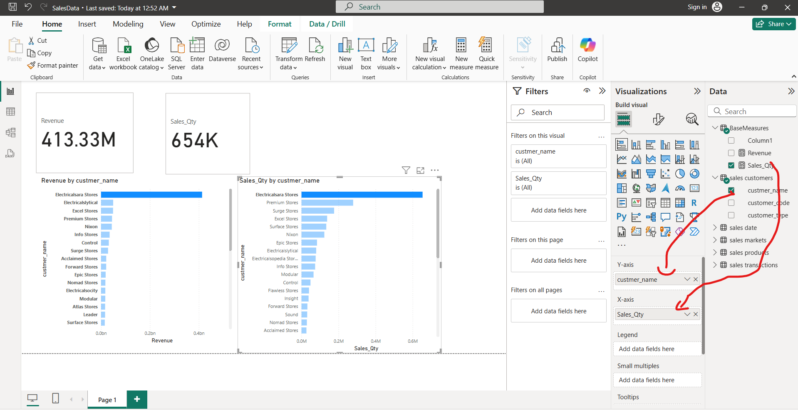

Slide 13
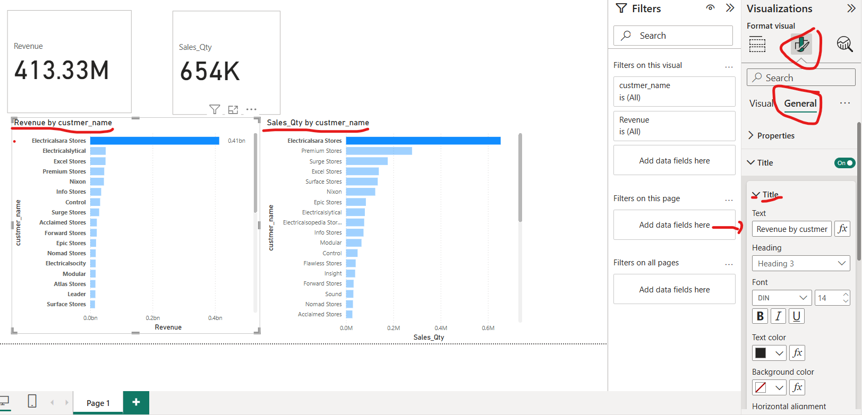
Change both of the titles

Slide 14
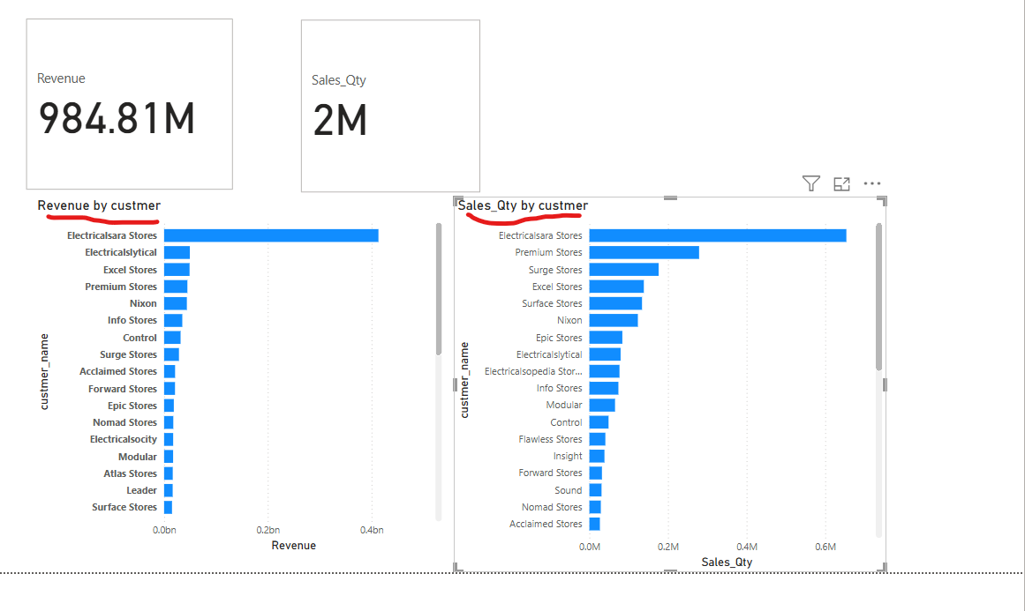
Titles names are more meaningful now

Slide 15
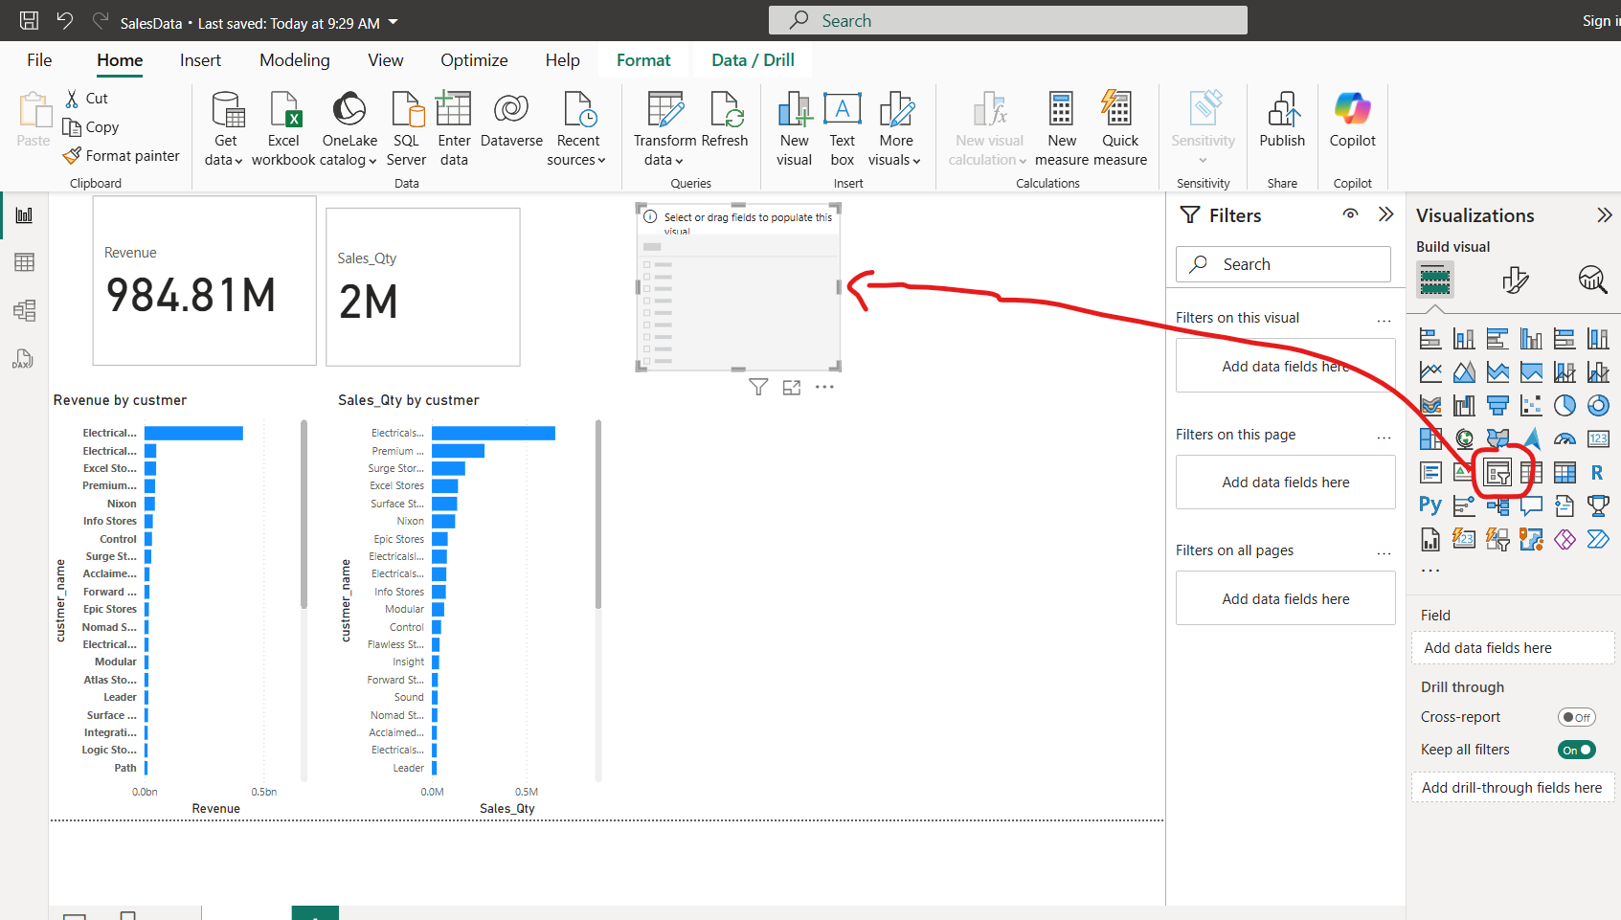
Put a slicer on a dashboard

Slide 16
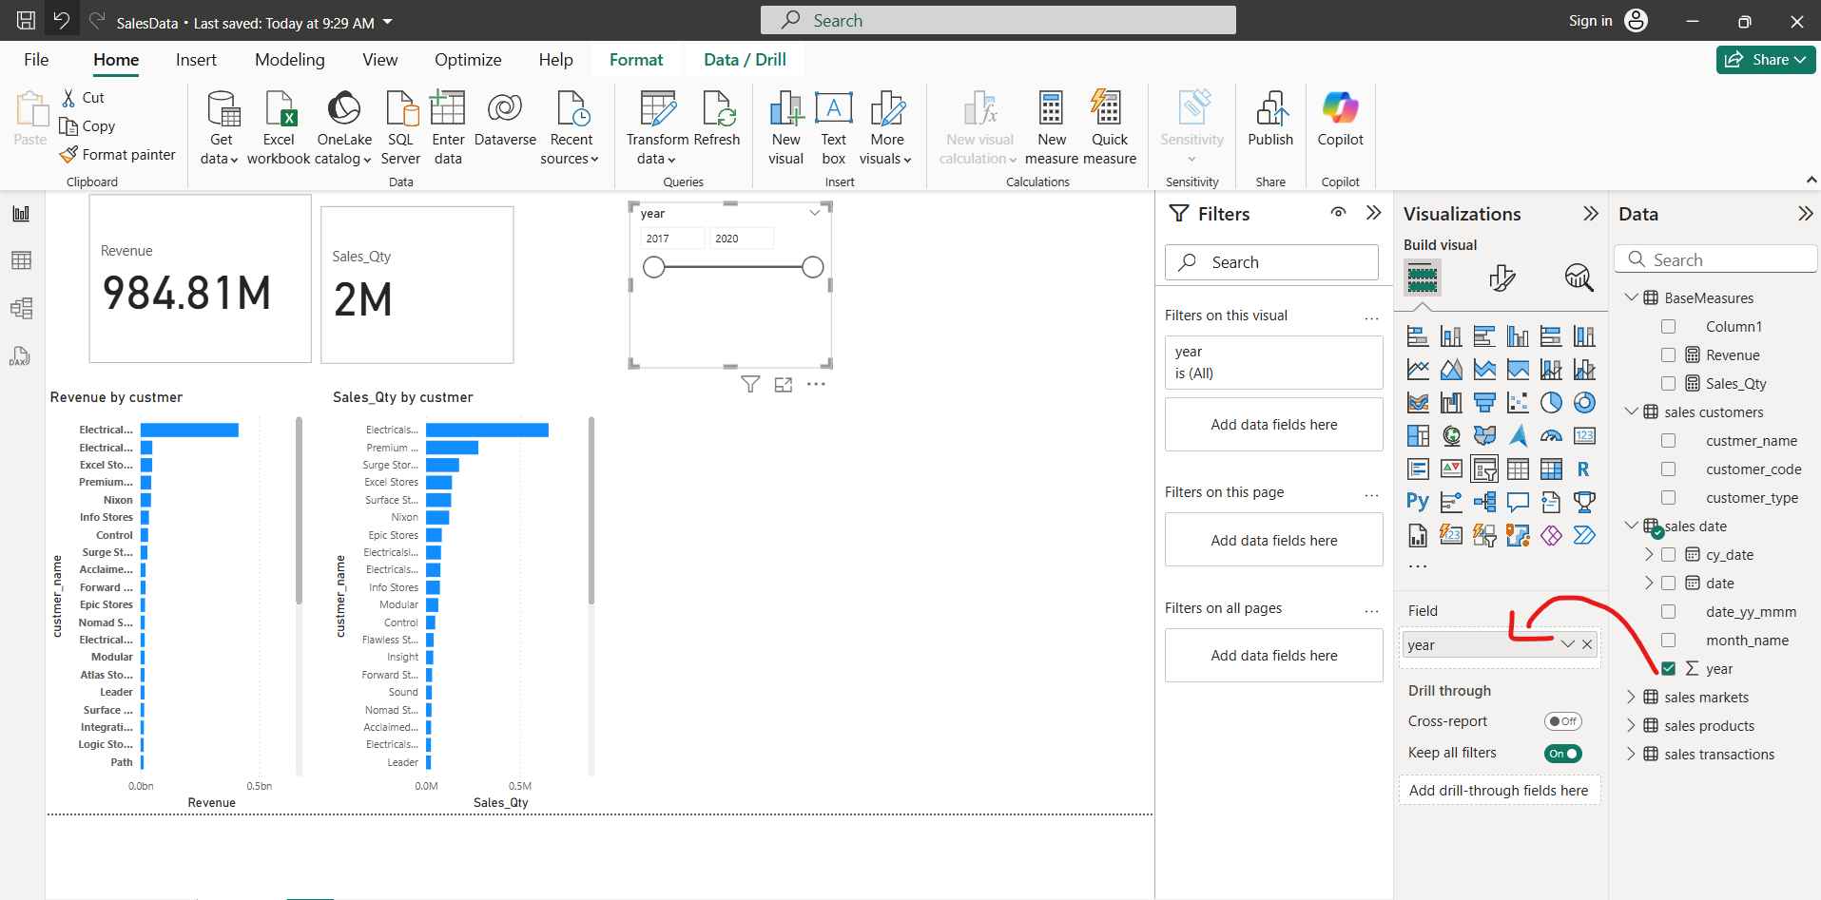
Put an Year on a slicer field

Slide 17
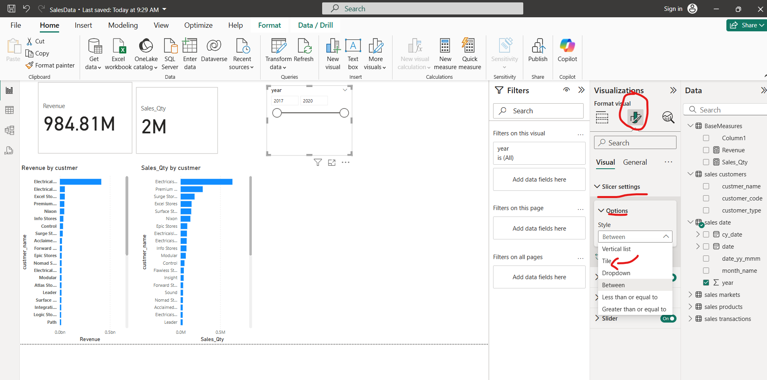
Goto settings and click on style type “tiles”

Slide 18
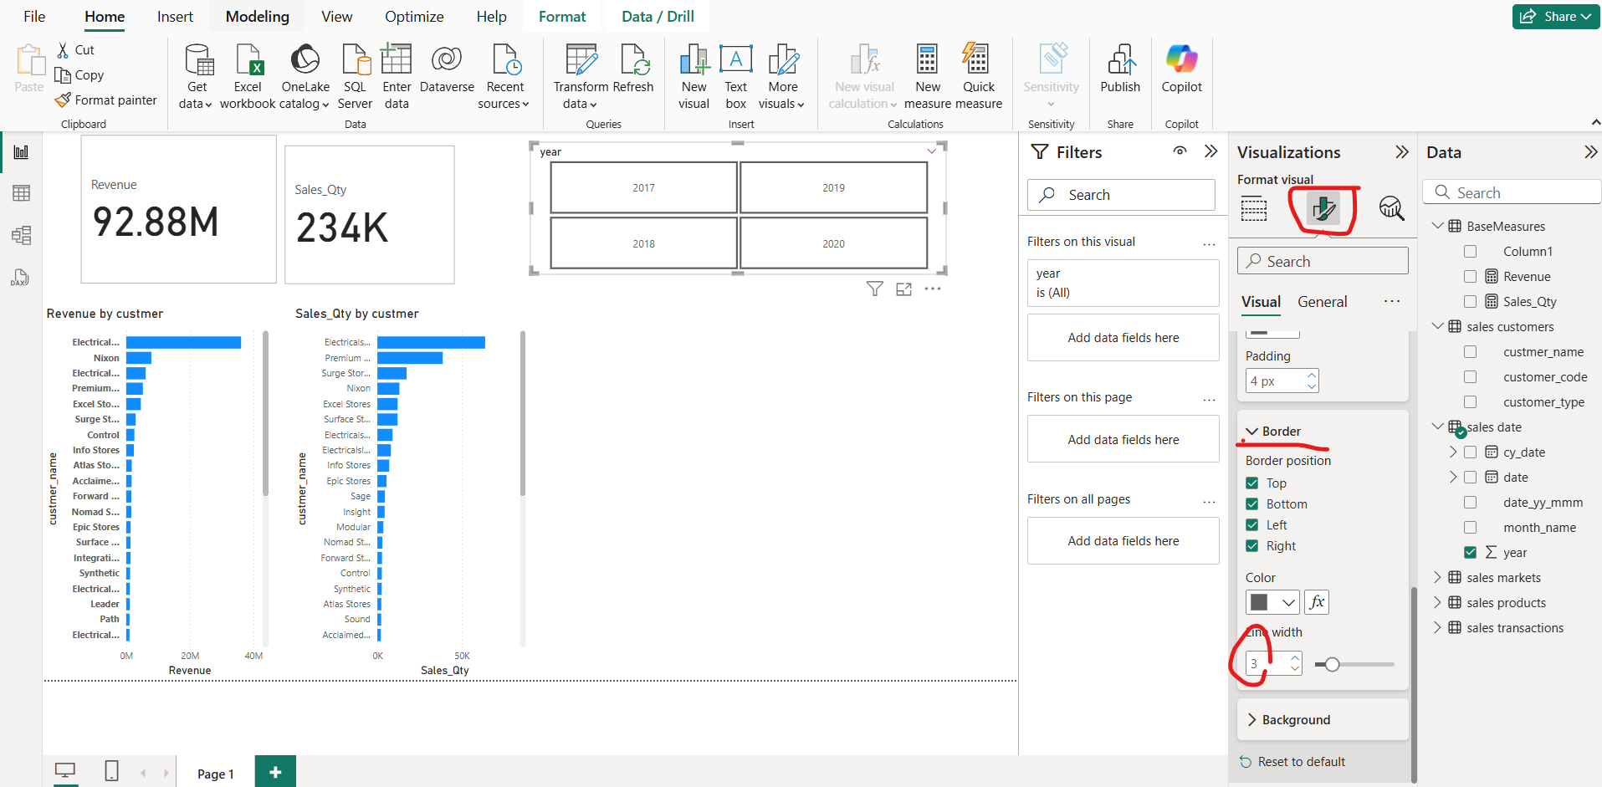
Tiles would appear and thickening of borders would occur via format option

Slide 19
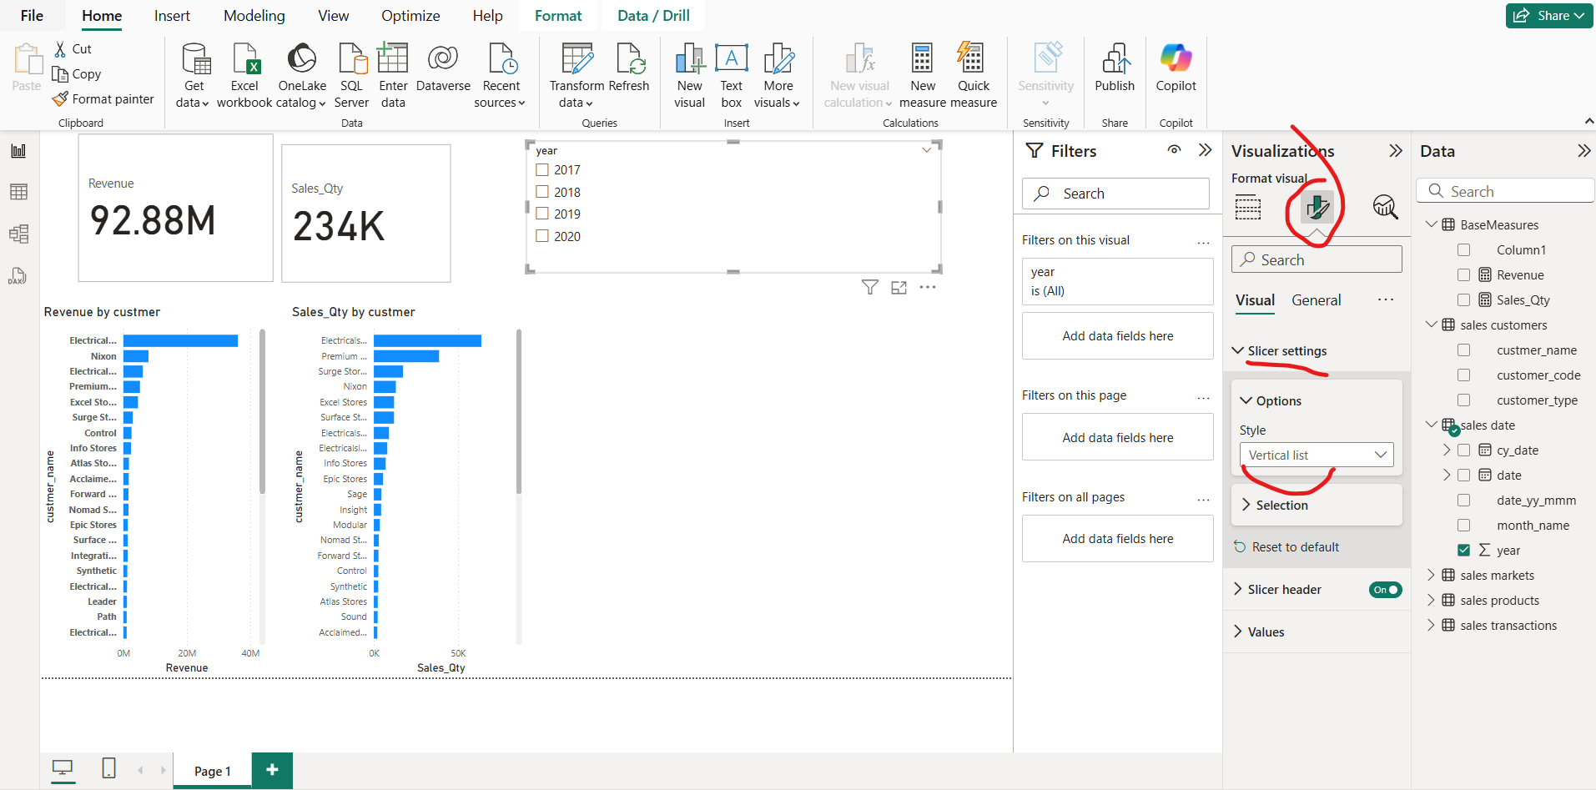
You can create a horizontal list style of year too, First create a vertical list

Slide 20
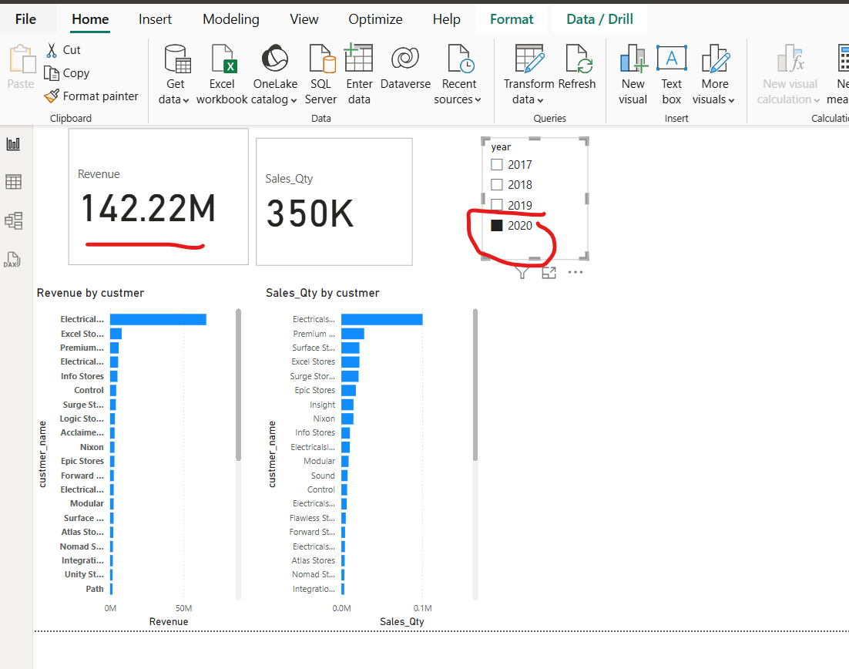
How can you verify year 2020 has a revenue of 142.22M?? GOTO mysql workbench

Slide 21
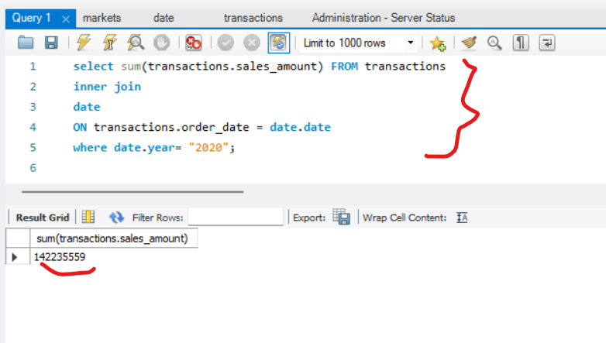
Similar total revenue as displayed in power BI Dashboard

Slide 22
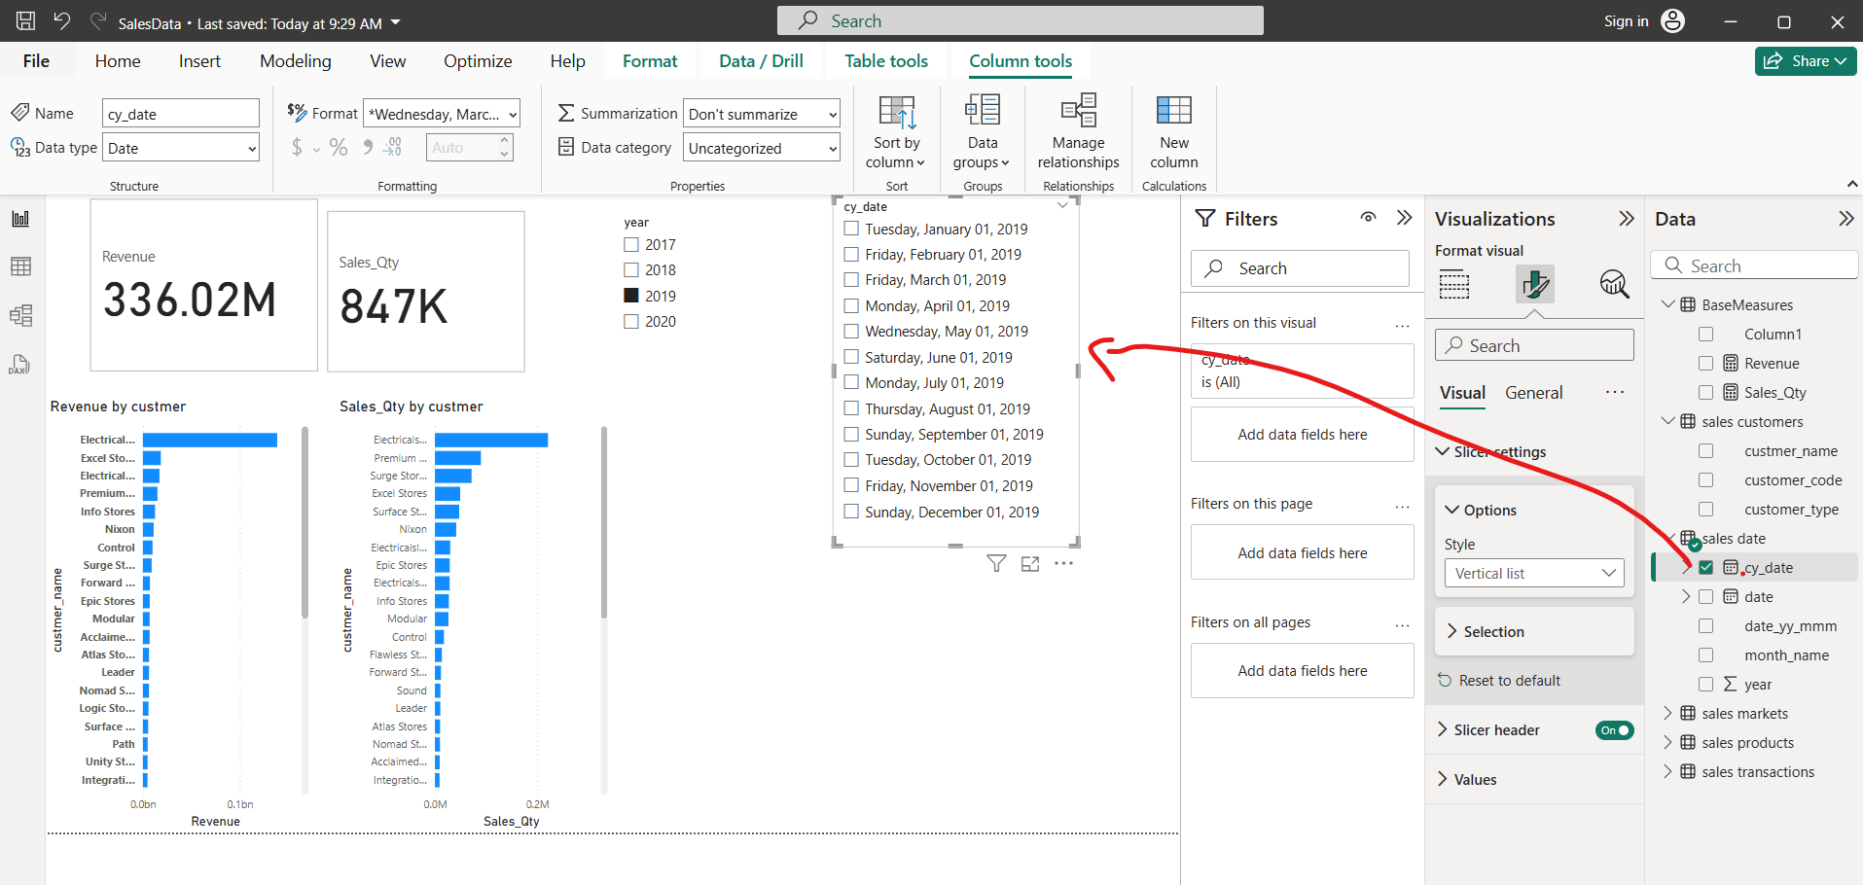
Produce another slicer of type “vertical”

Slide 23
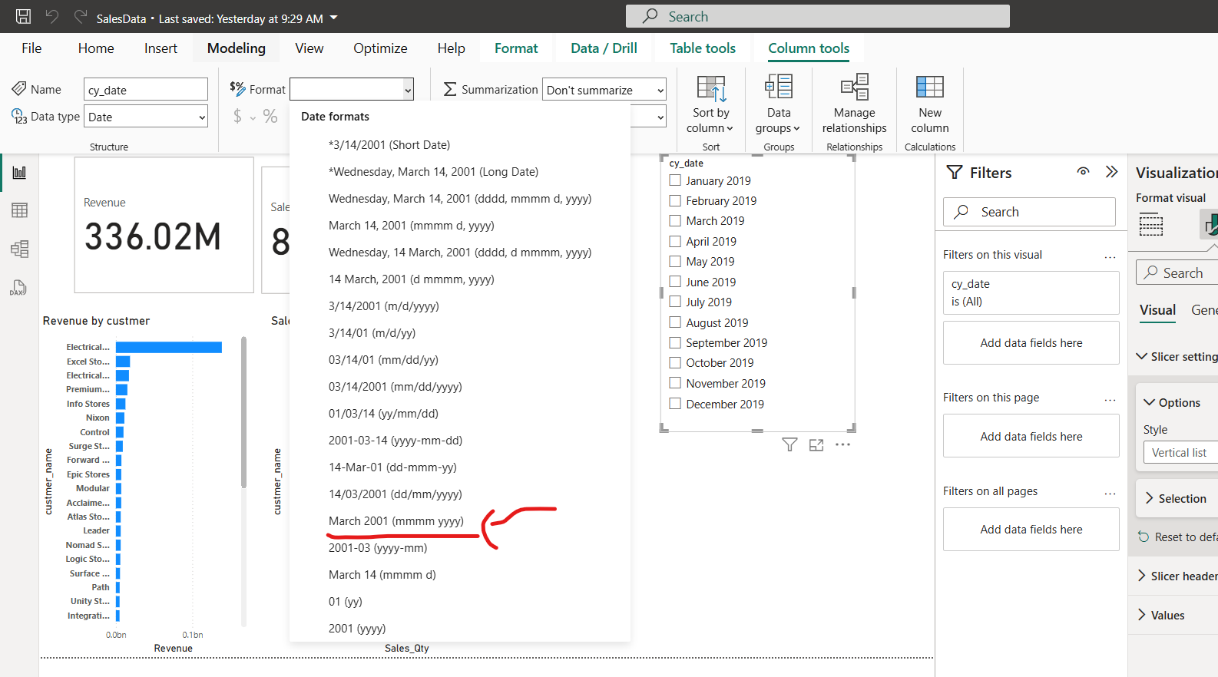
Change the date format into Month and Year only

Slide 24
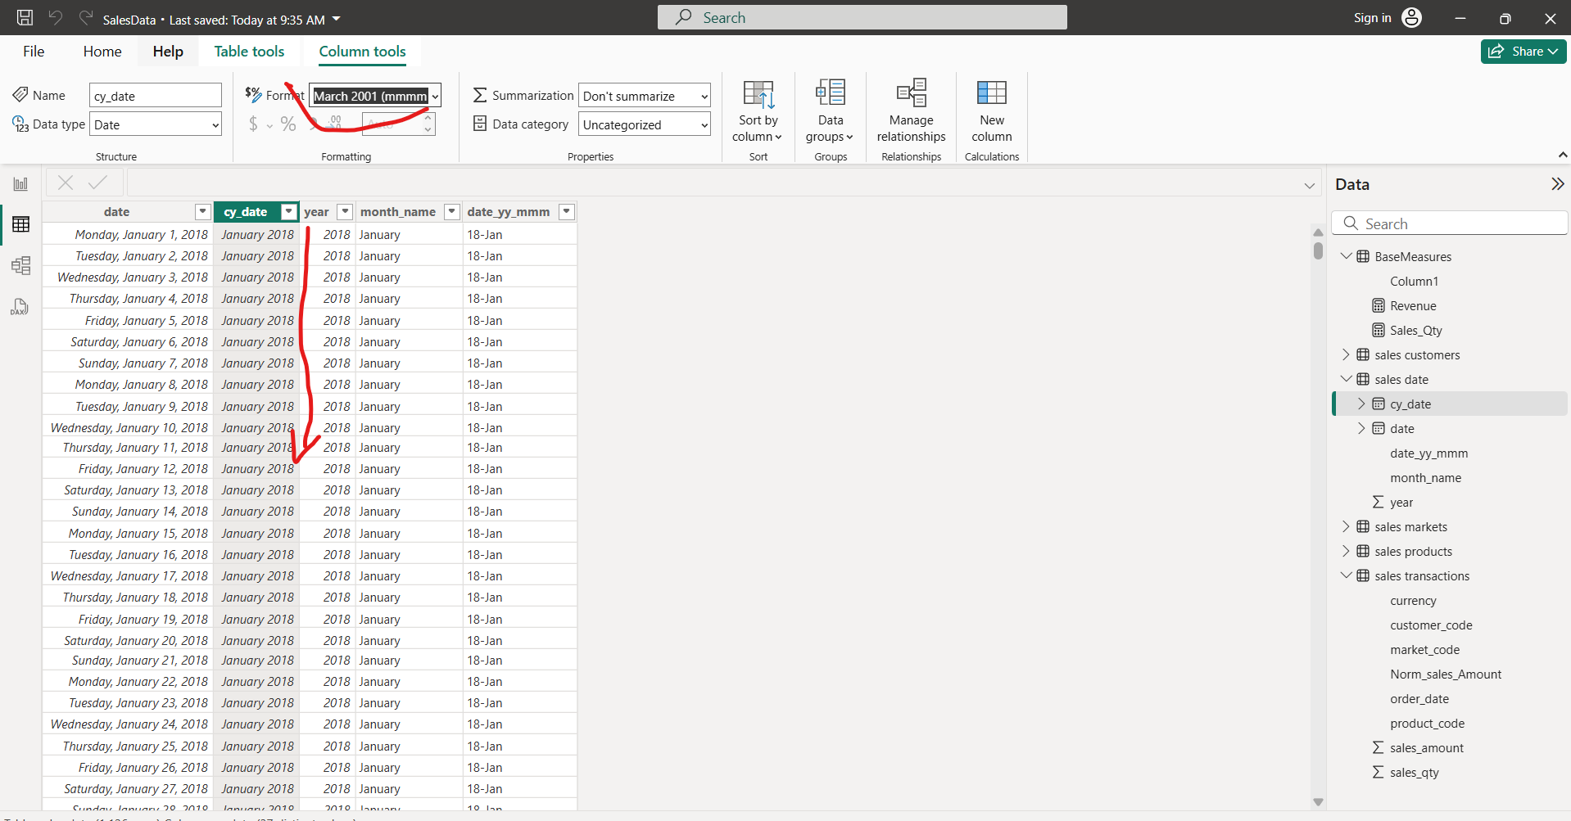
Another way to change date format

Slide 25
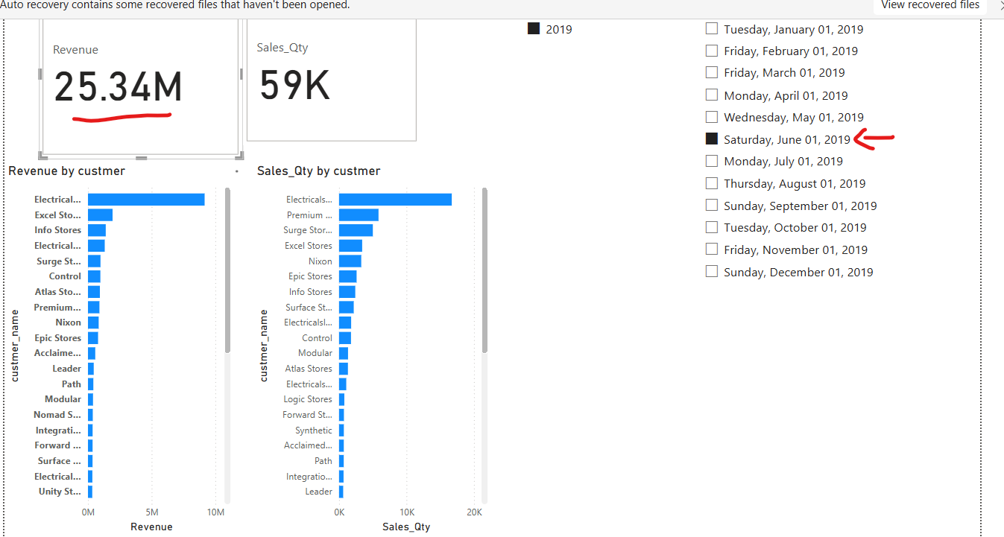
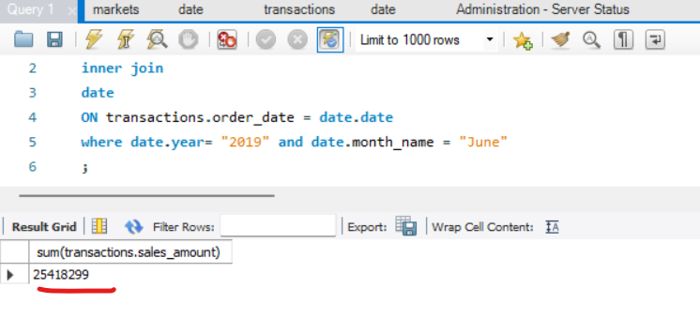
Open sql and run queries to compare Power BI revenue and SQL result.. And tey are Same

Slide 26
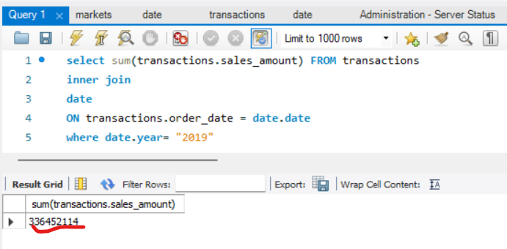
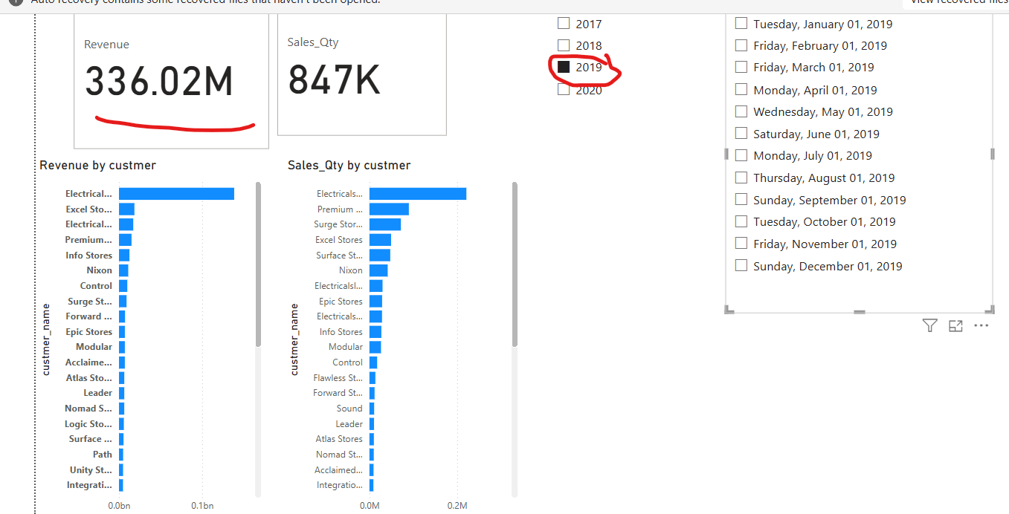
Compare Year revenue from Mysql Query and power BI dashboard→ same resul

Slide 27
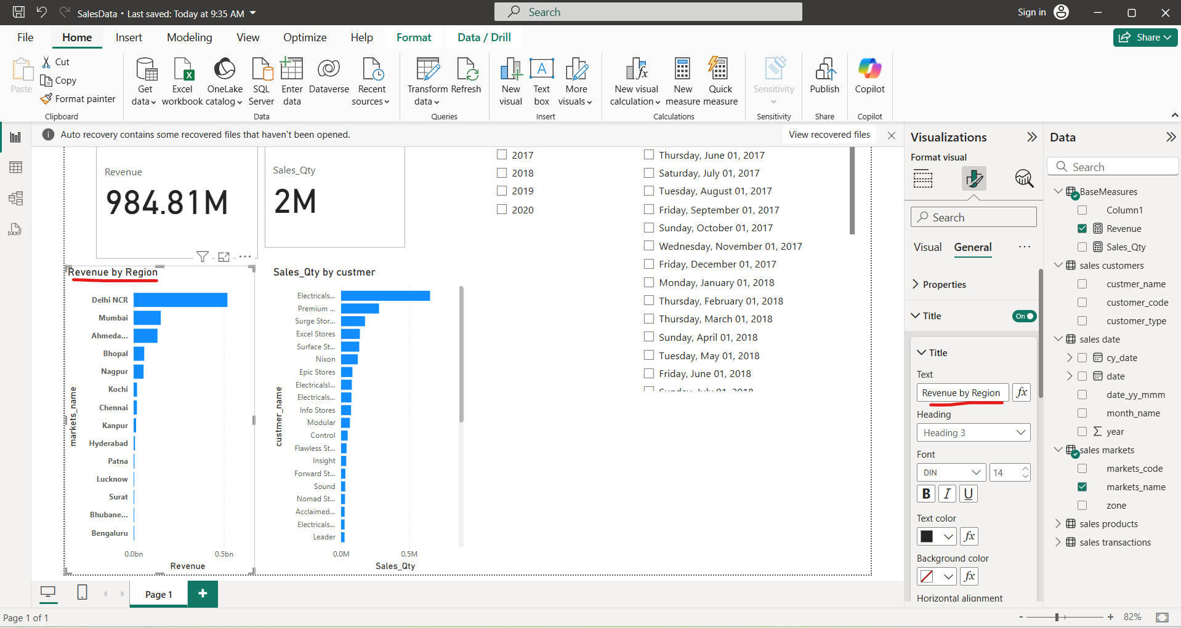
Now generate revenue by region

Slide 28
Show top five cutomers givin you the max business

Slide 29
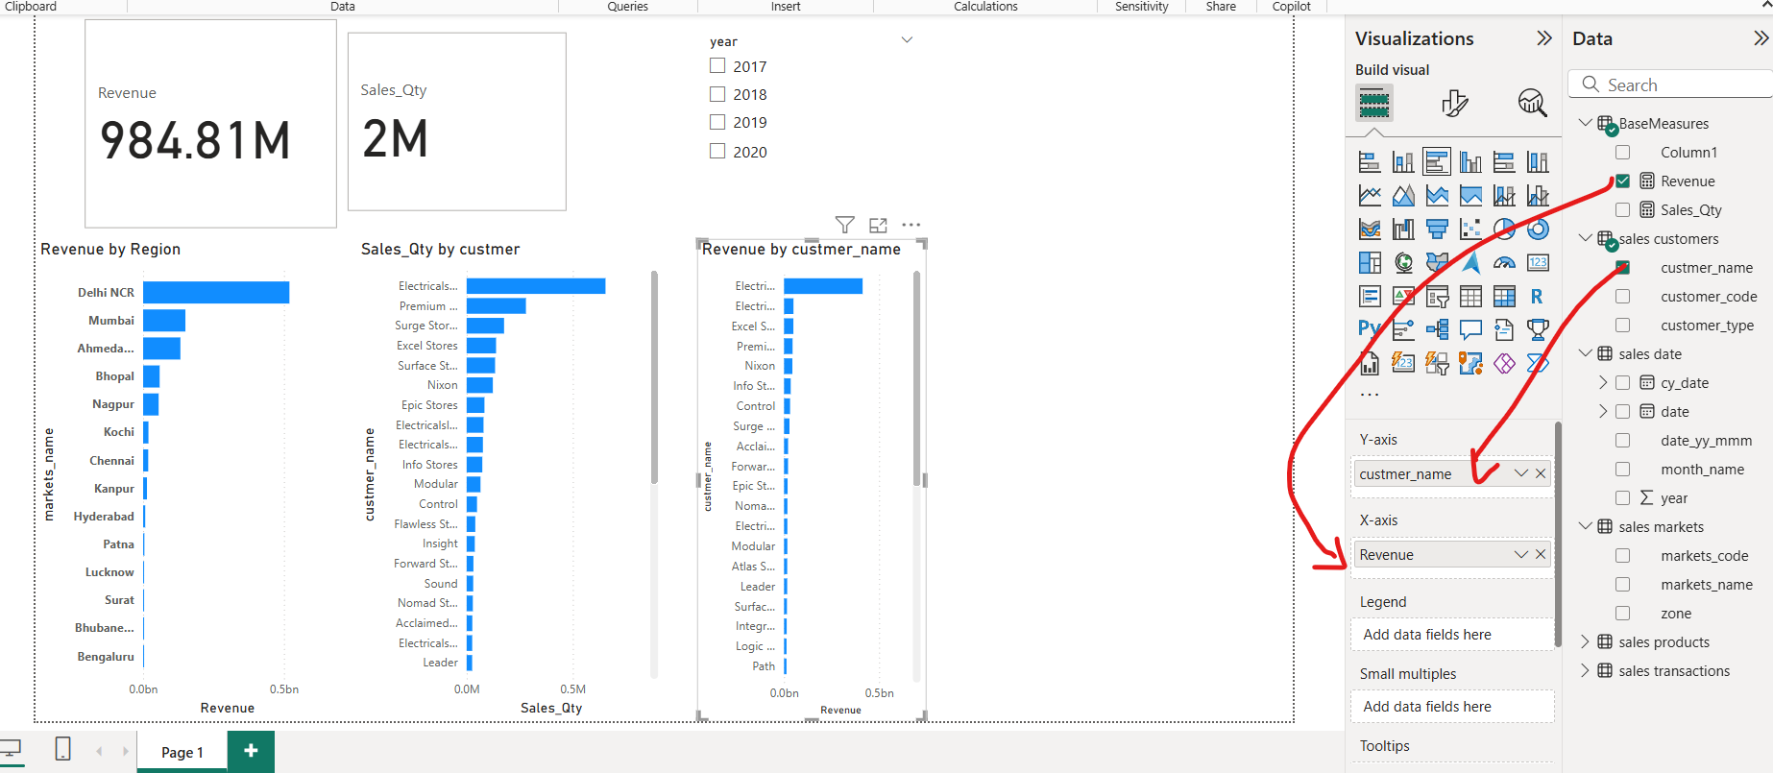
Simple revenue by customer name

Slide 30
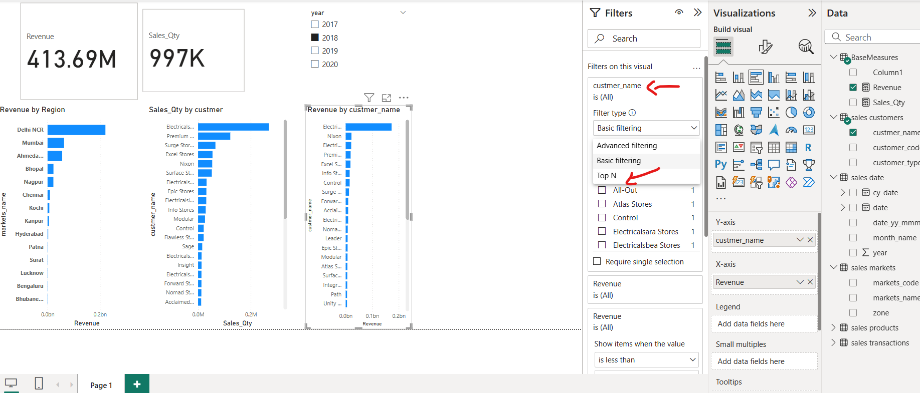
For Top five customers

Slide 31
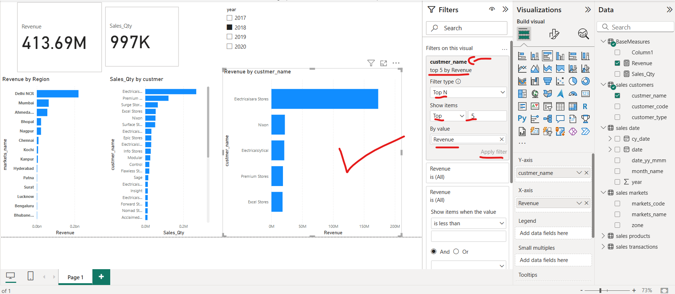
Write “5” on top N to et top 5 customers wo generate sales

Slide 32
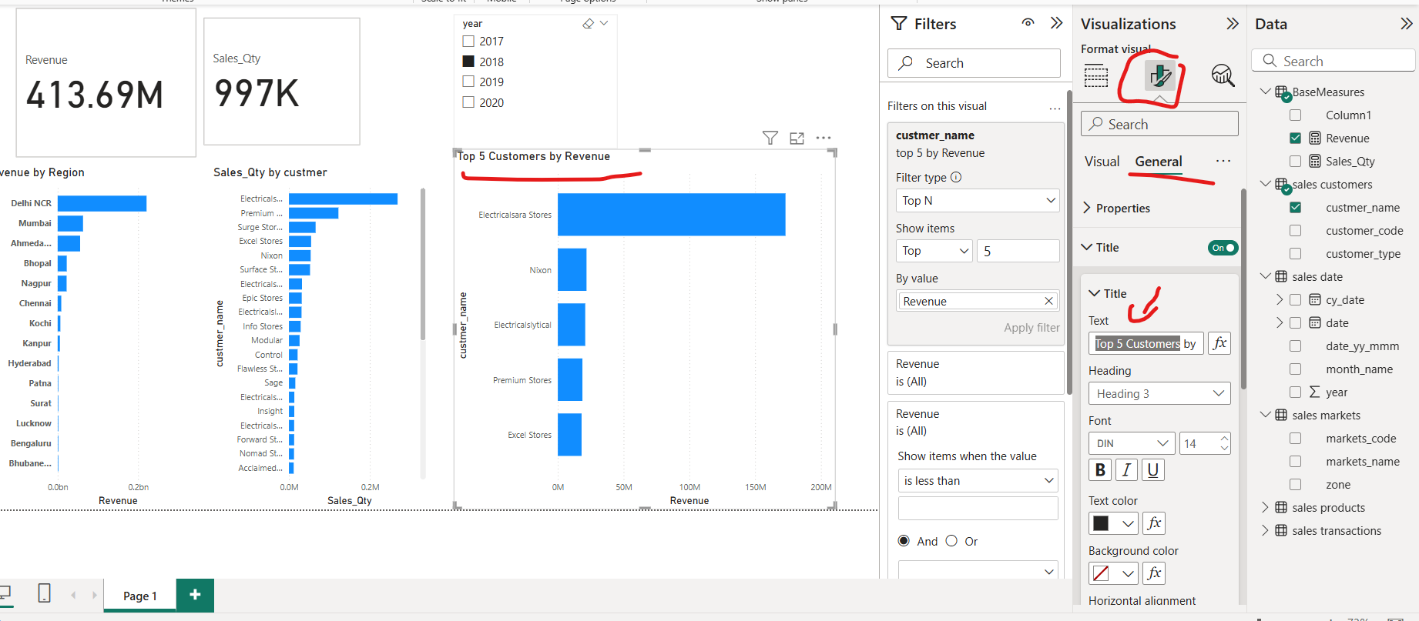
go to to general settings and change the title name of the graph

Slide 33
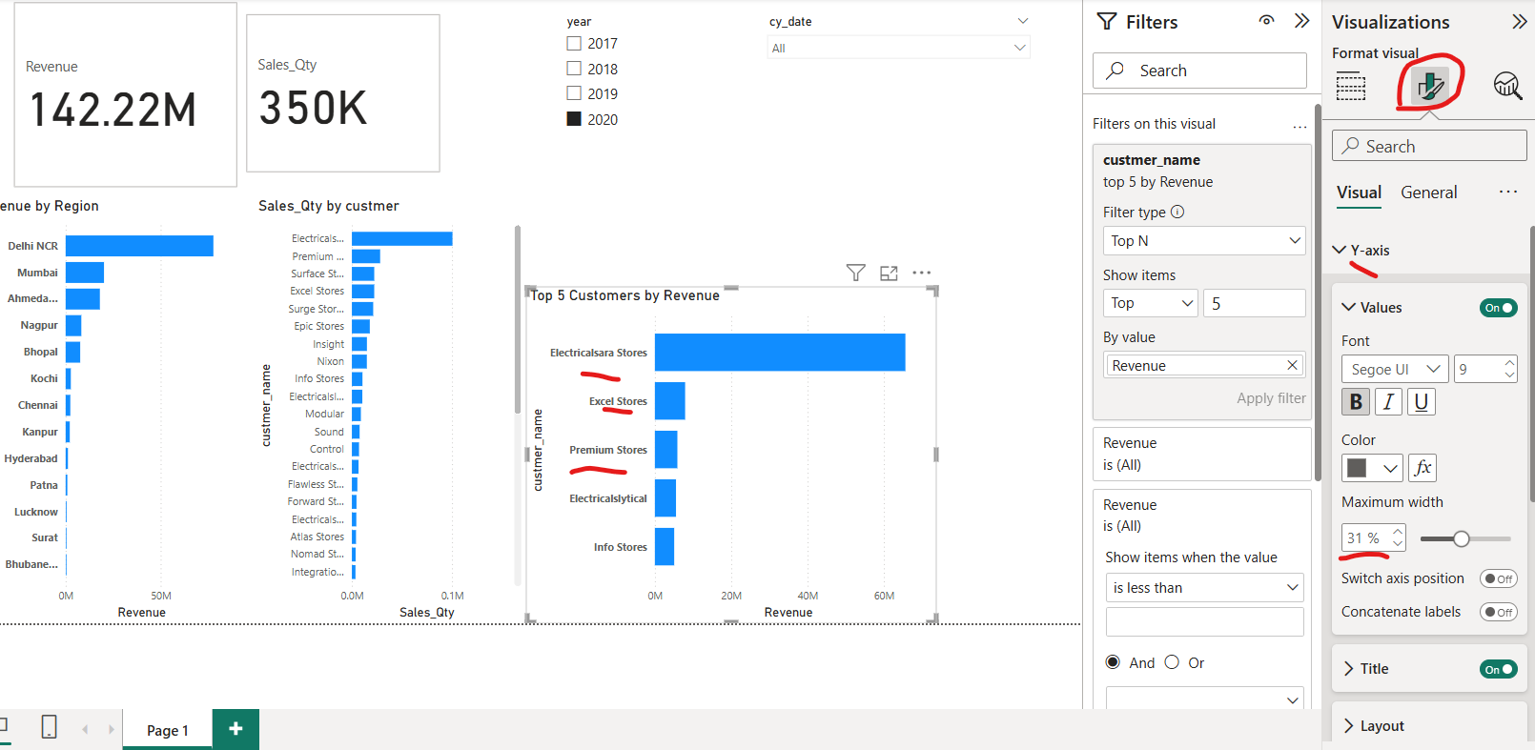
GOTO Y-axis settings and increase its font

Slide 34
Top 5 Products

Slide 35
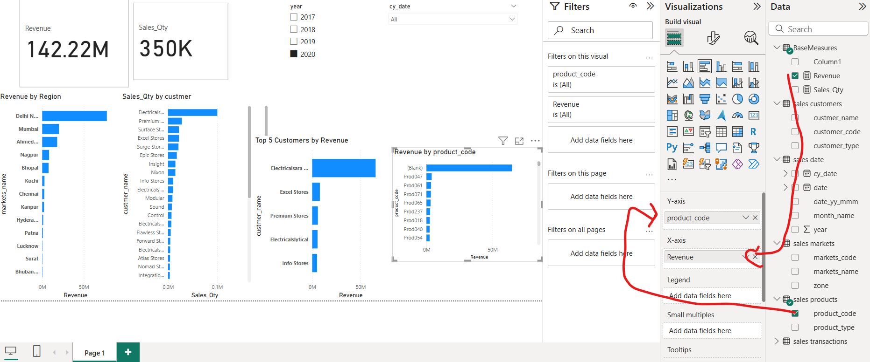
Again get a bar Chart and compare product code by Revenue

Slide 36
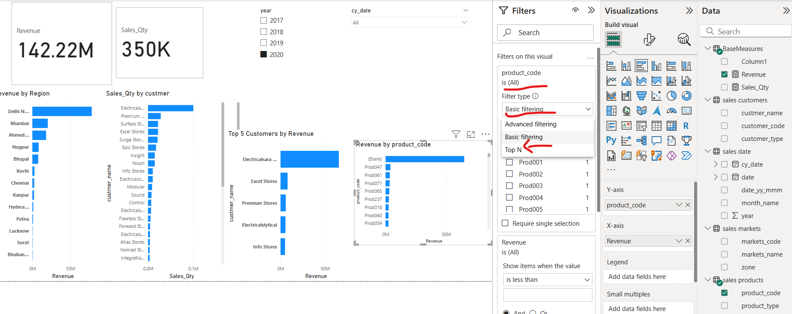
Filter top 5 product in terms of revenue and refine the bar chart

Slide 37
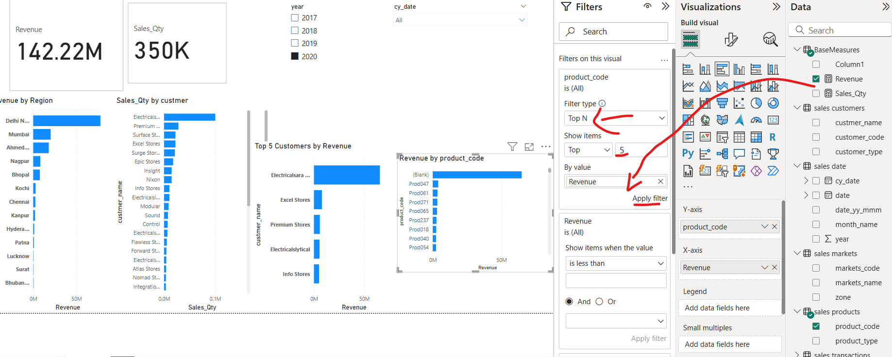
Click on “Apply now”

Slide 38
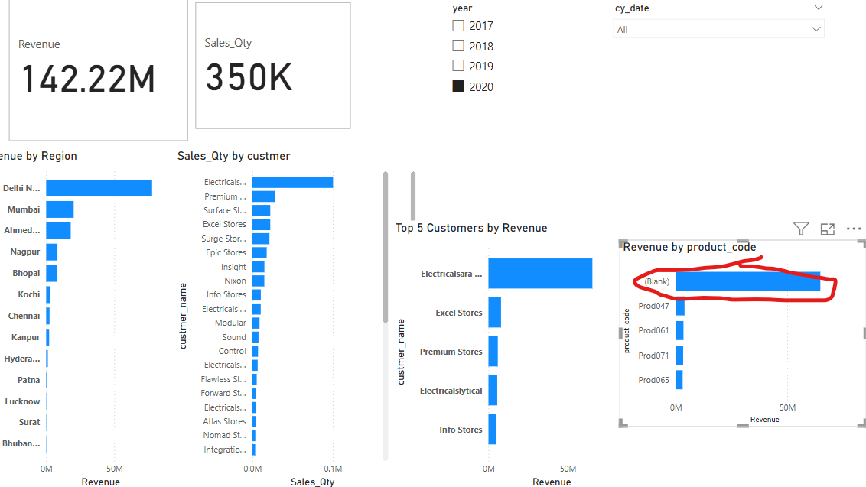
How would you tackle such data?
Being data analyst you are suppose ask the company to get the data right
The max decisions based on product and their sales

Slide 39
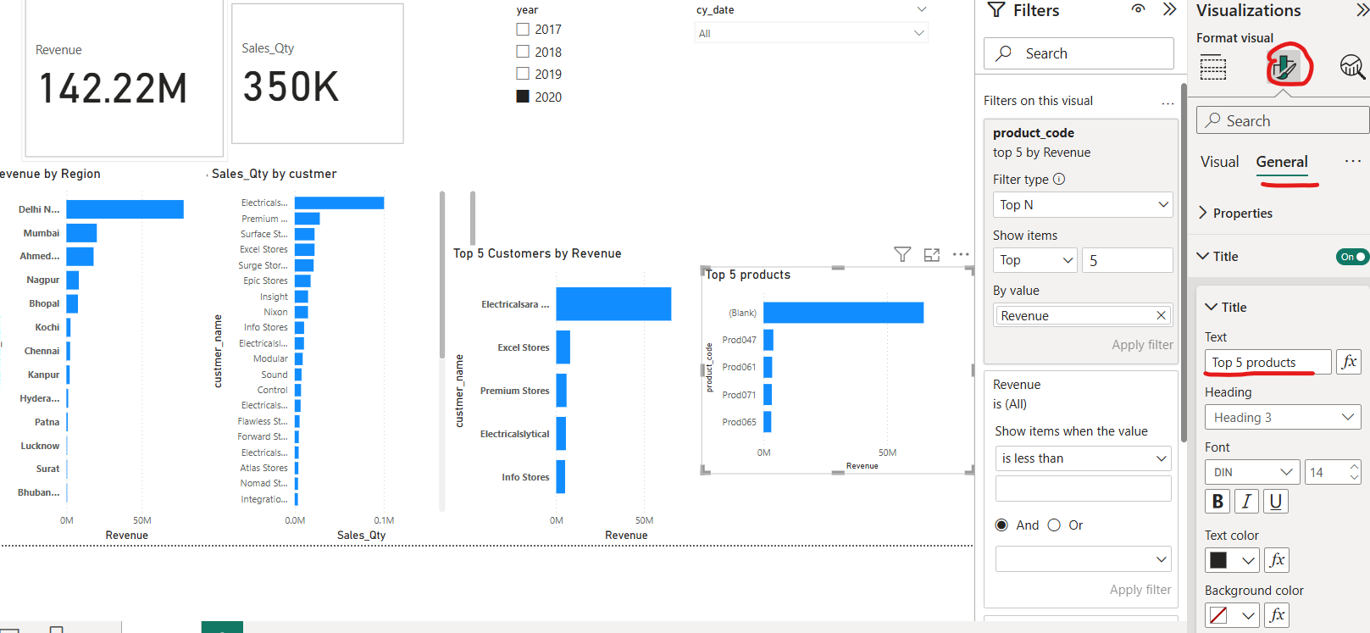
Goto formatting Pane-> general-> title to change title of a bar chart

Slide 40
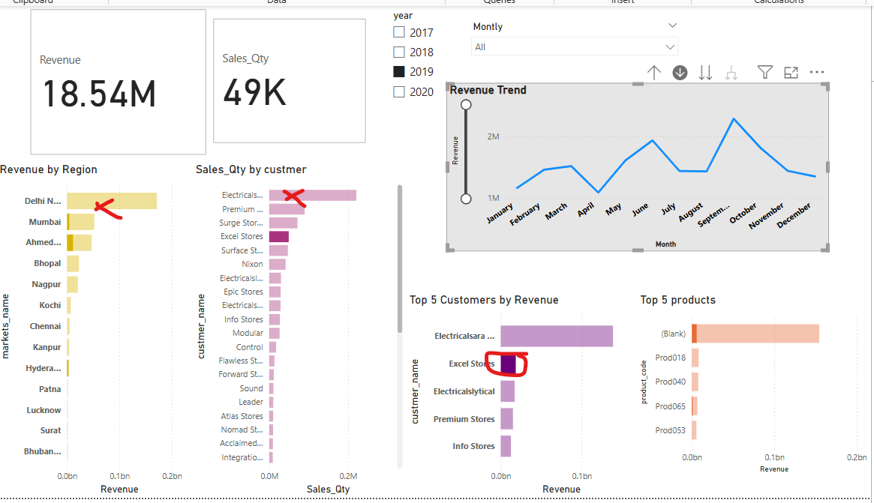
As we filter via clicking bar you see for example “Dehli” and many other bars are not contributing to the filtered desired results. This creates the confusion

Slide 41
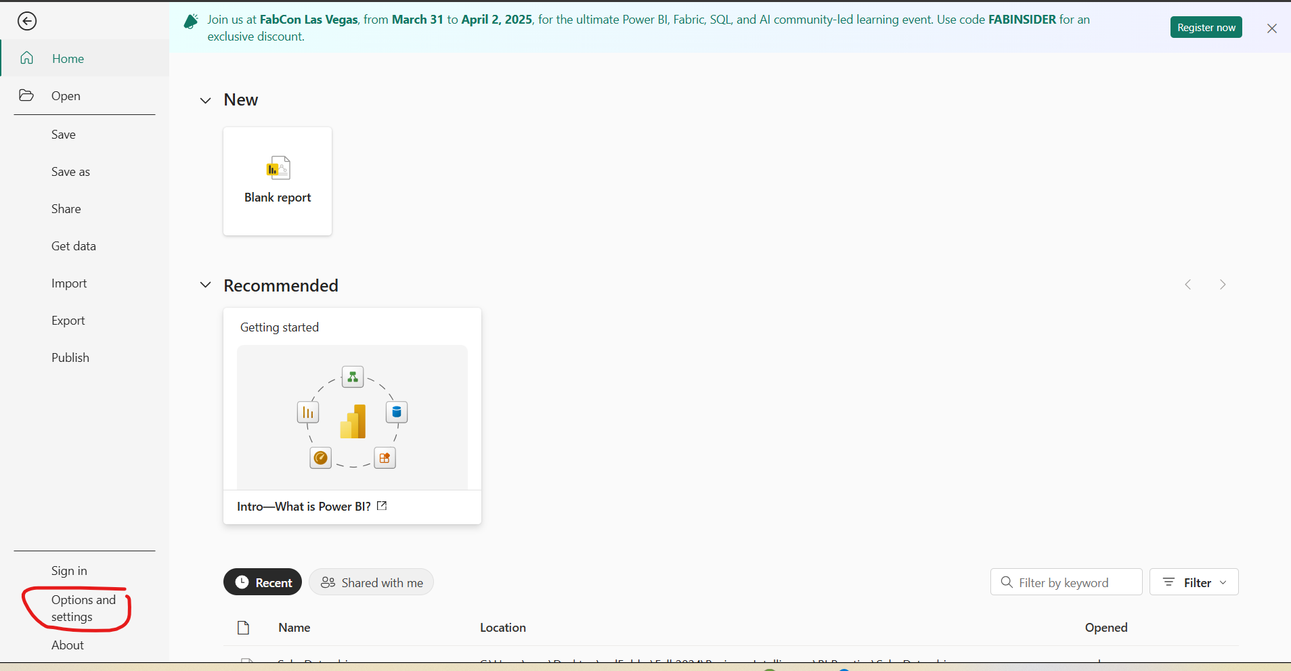
To resolve confusion of filtered bars appearing, goto “options and settings”

Slide 42
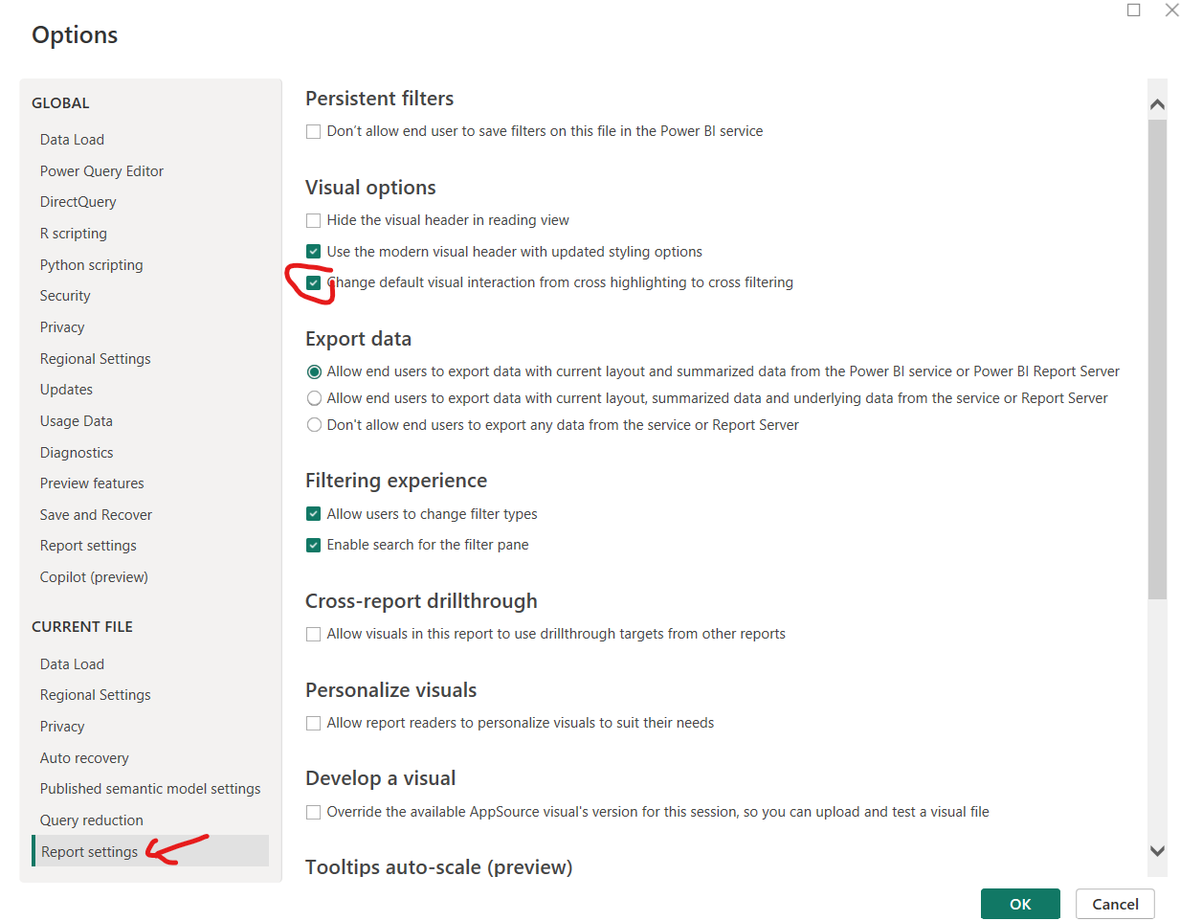
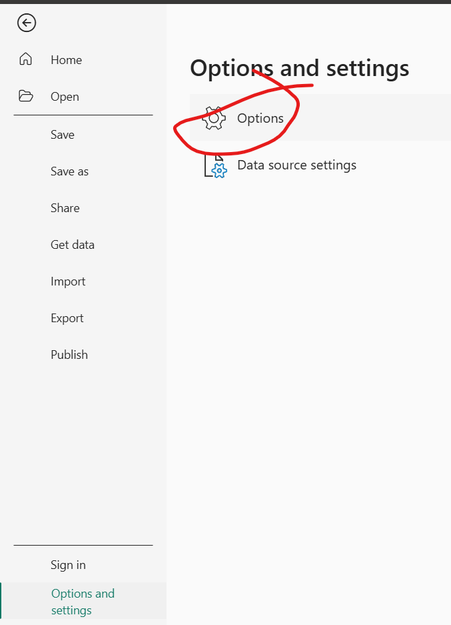
Report Settin

Slide 43
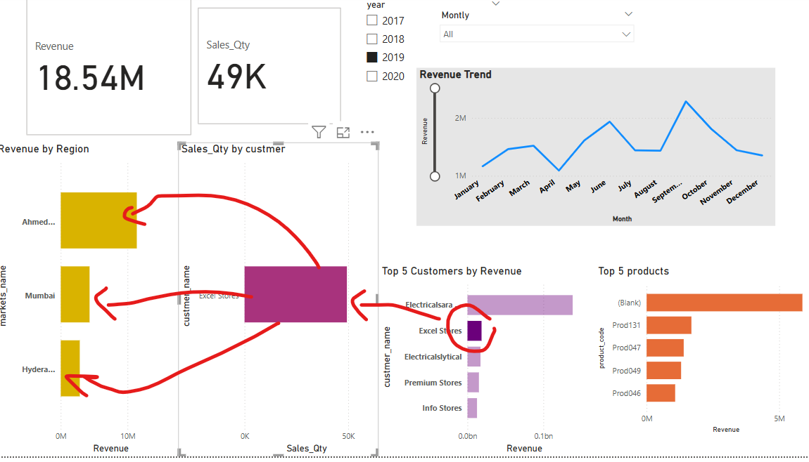
Problem solved

Slide 44
Mobile view of client’s Dashboard

Slide 45
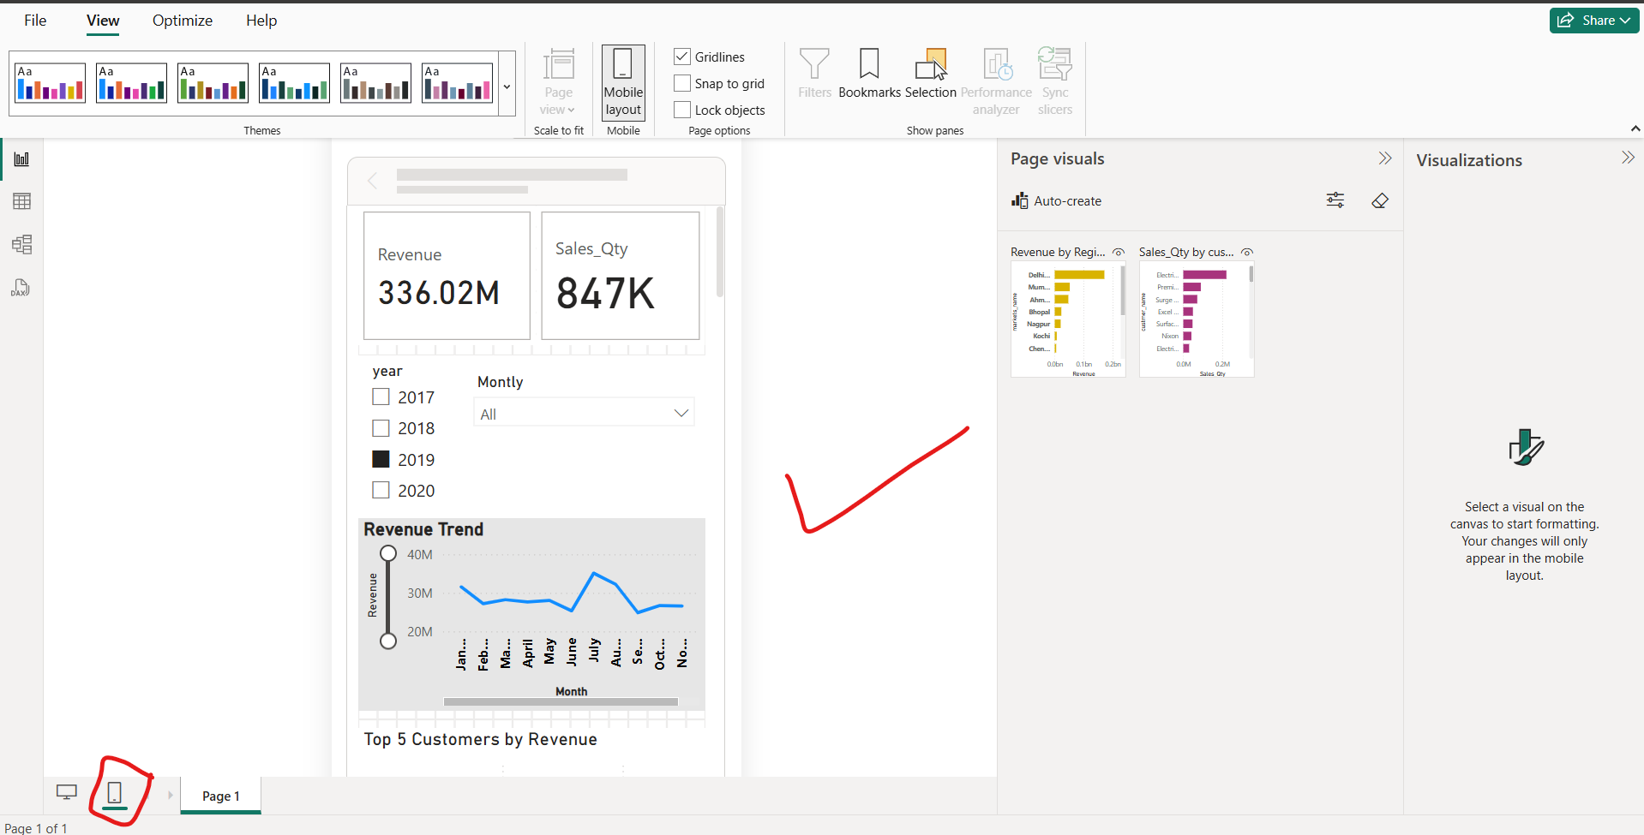
We have omitted extra charts

Slide 46
Client’s Feedback

